Slide 1
Control Panel

Slide 2
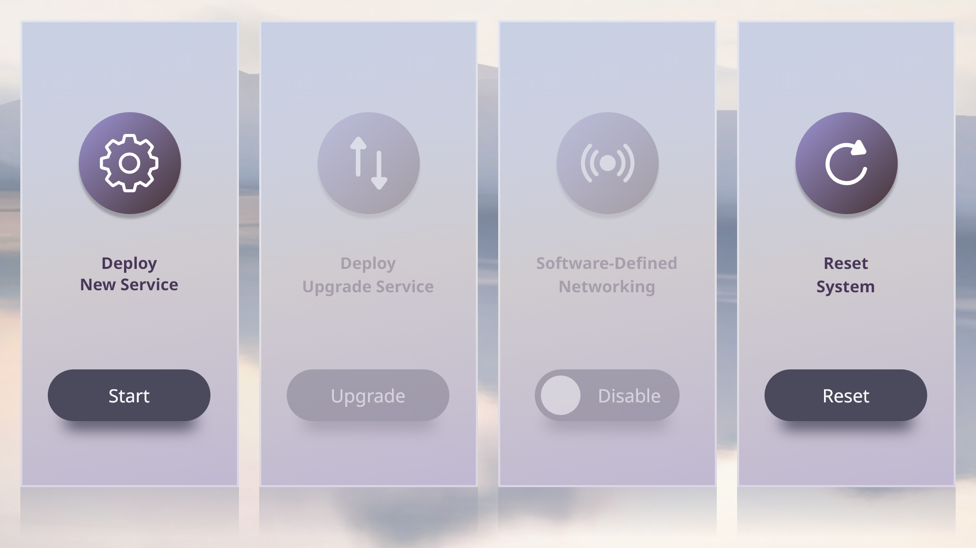
Control Panel – A

Slide 3

Control Panel – A(Deploy)

Slide 4
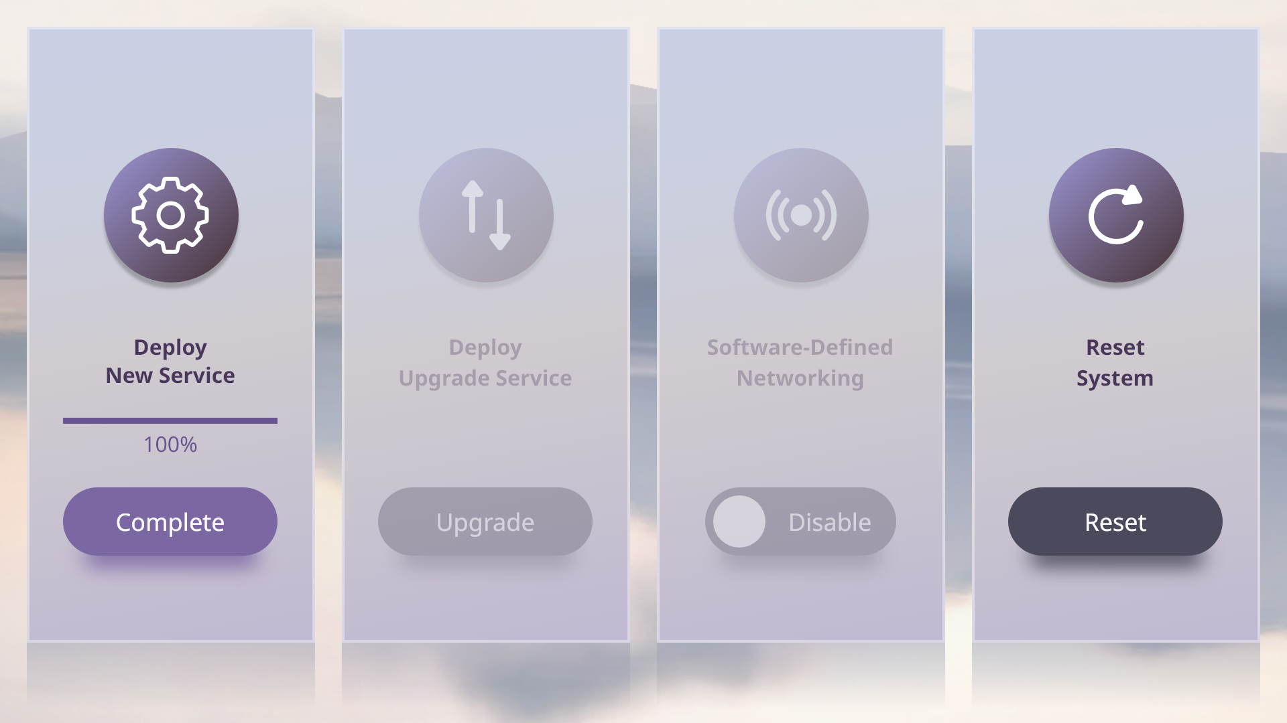
Control Panel – A(Deploy)

Slide 5
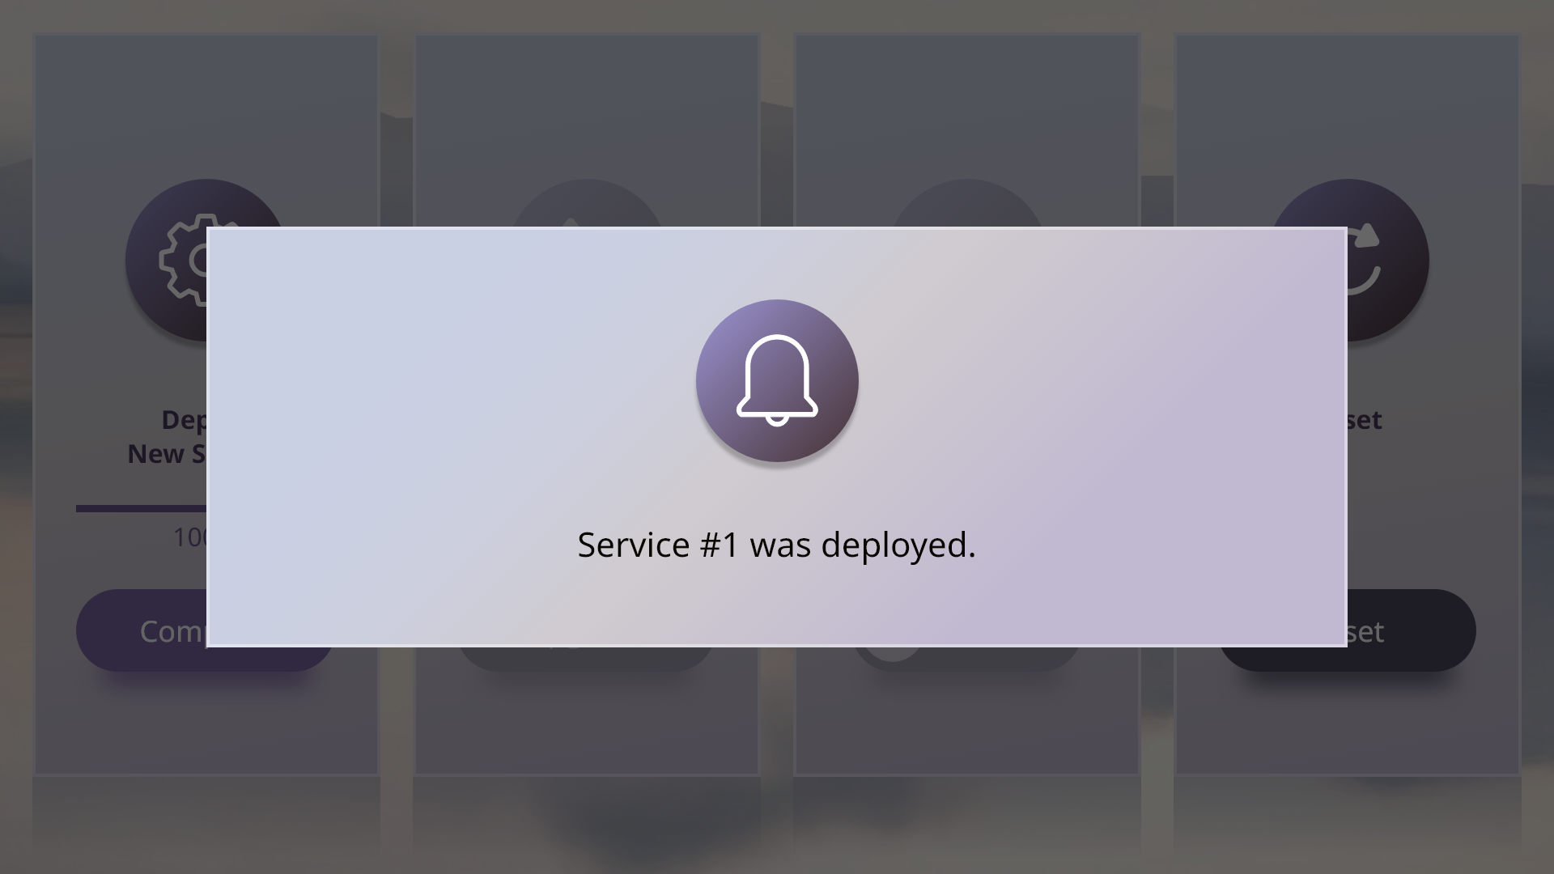
Control Panel – A(Deployed popup)

Slide 6
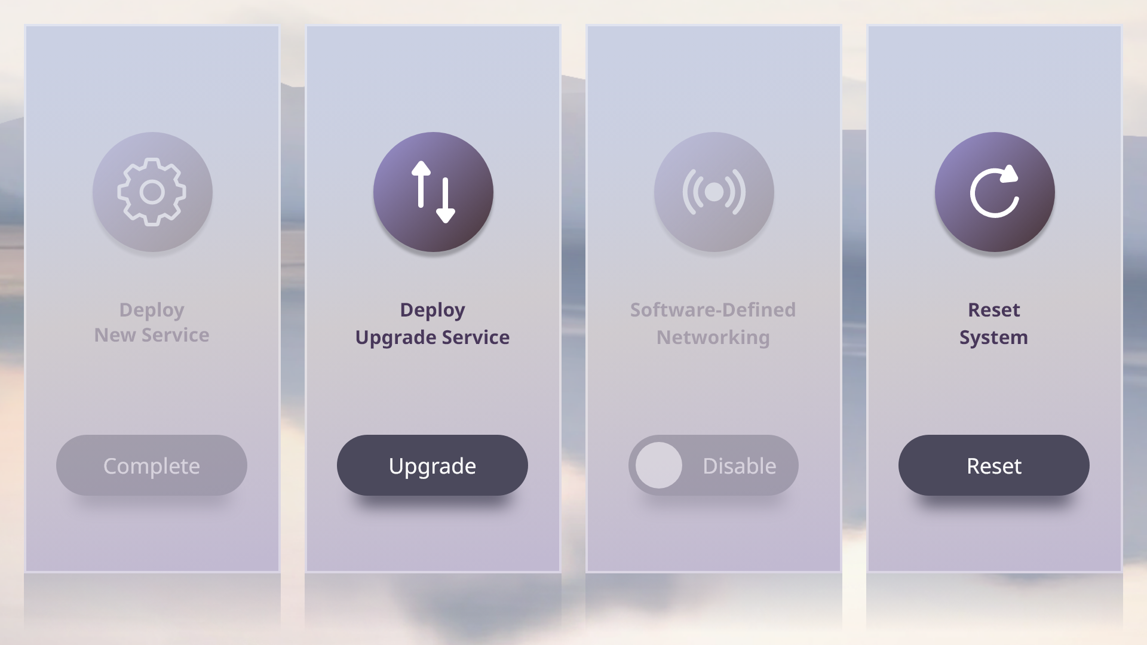
Control Panel – A(Upgrade)

Slide 7
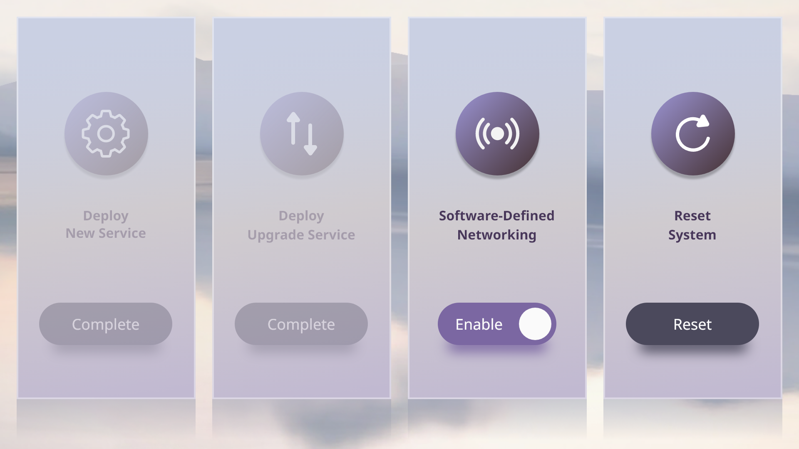
Control Panel – A(Enable SDN)

Slide 8
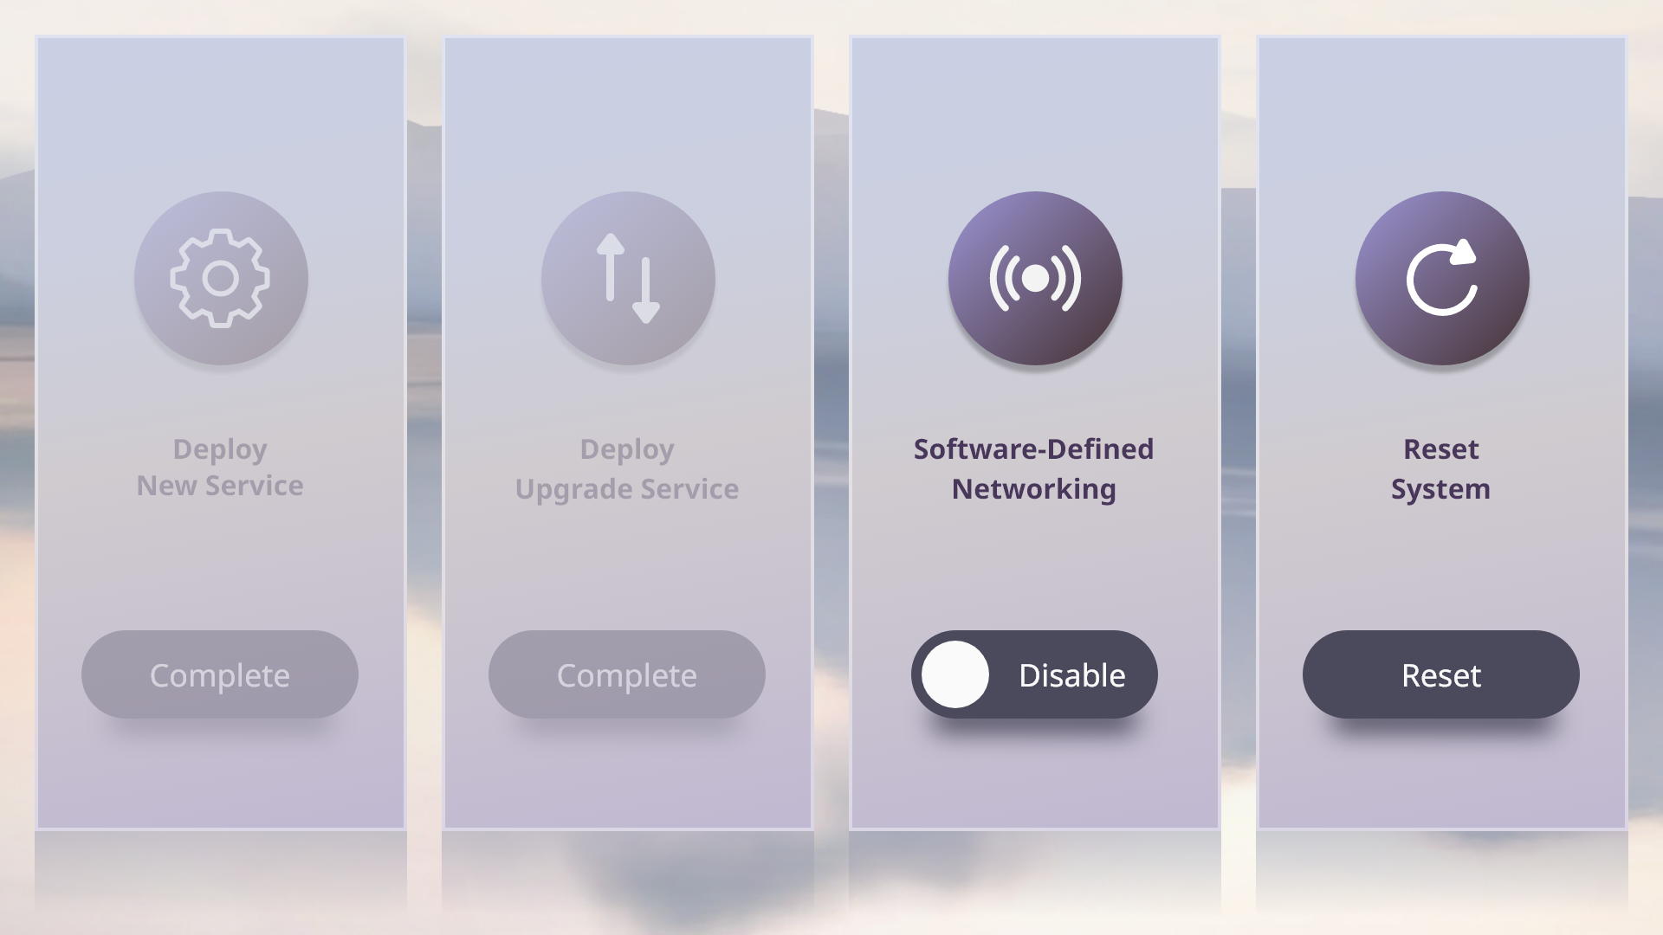
Control Panel – A(Disable SDN)

Slide 9
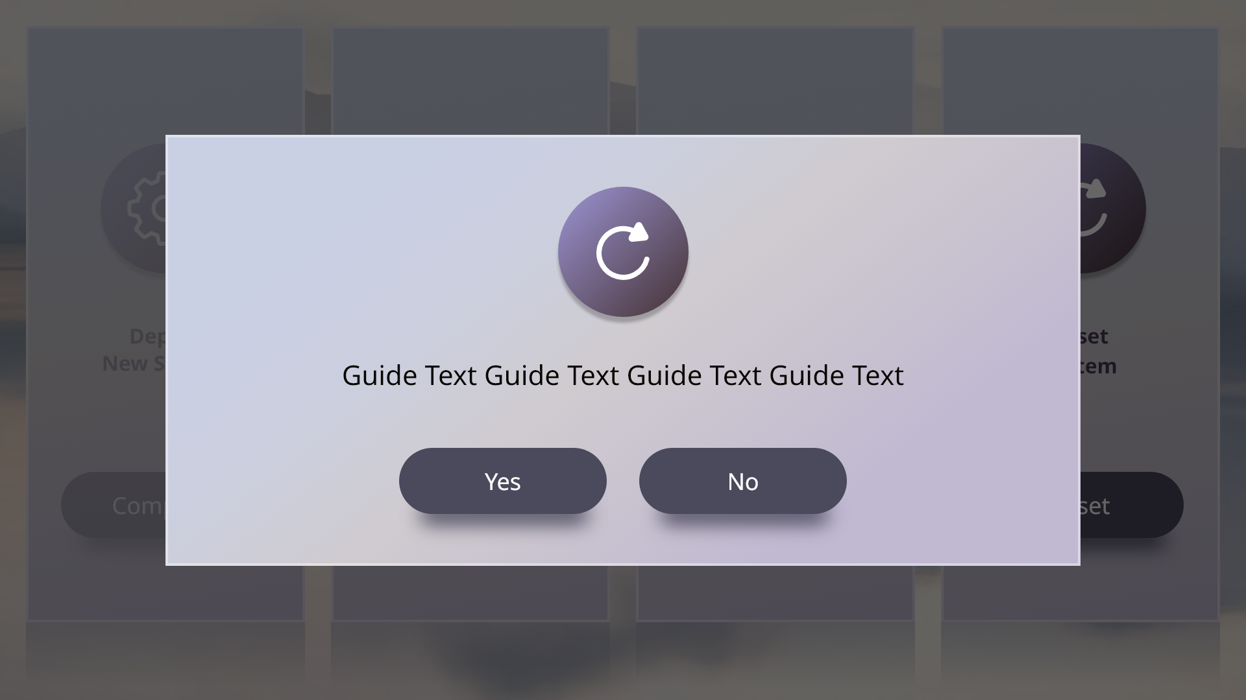
Control Panel – A(Reset popup)

Slide 10
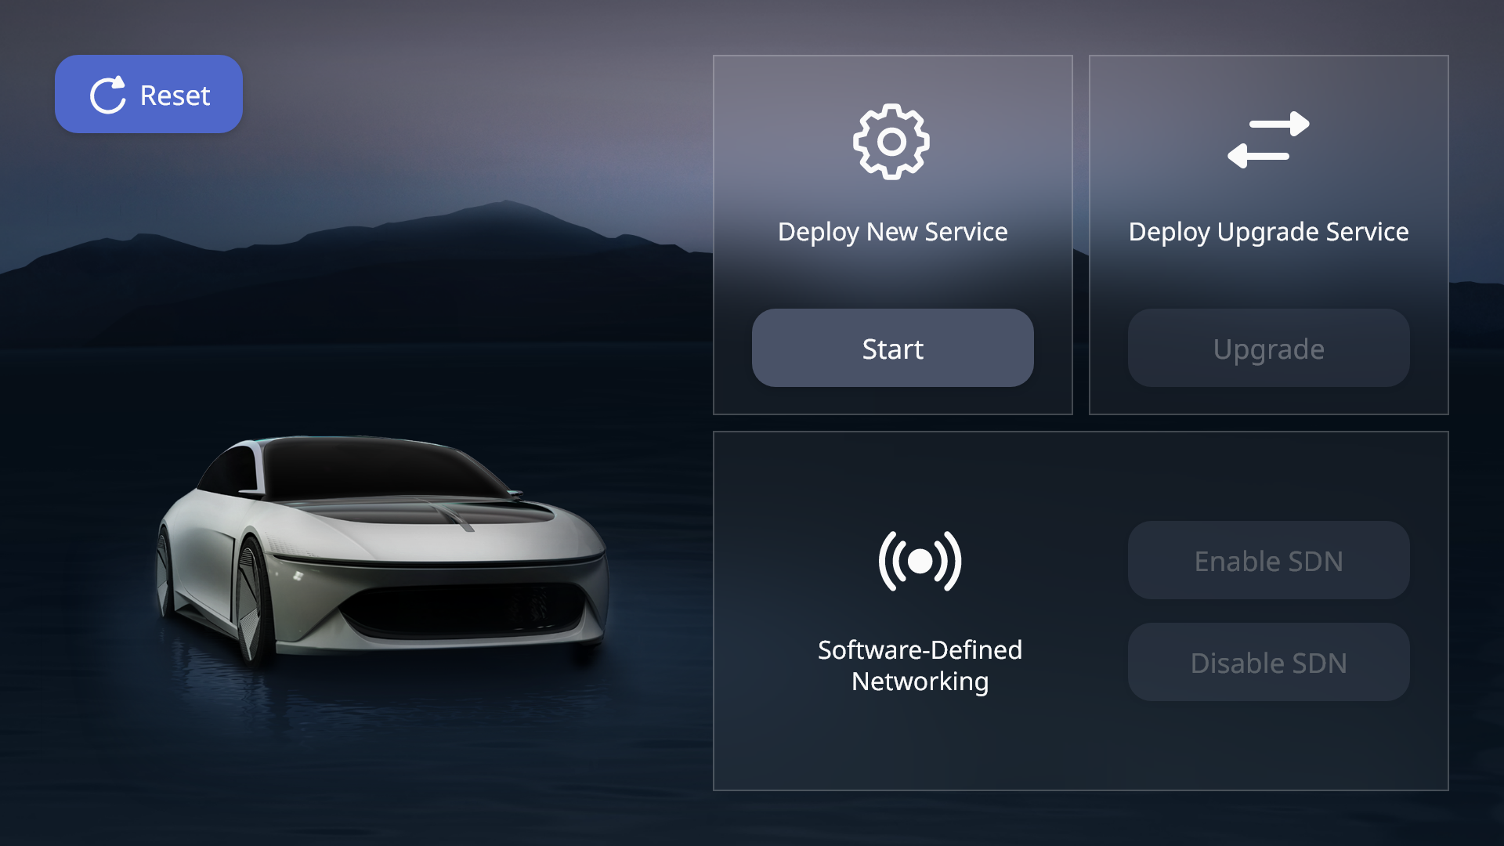
Control Panel – B

Slide 11
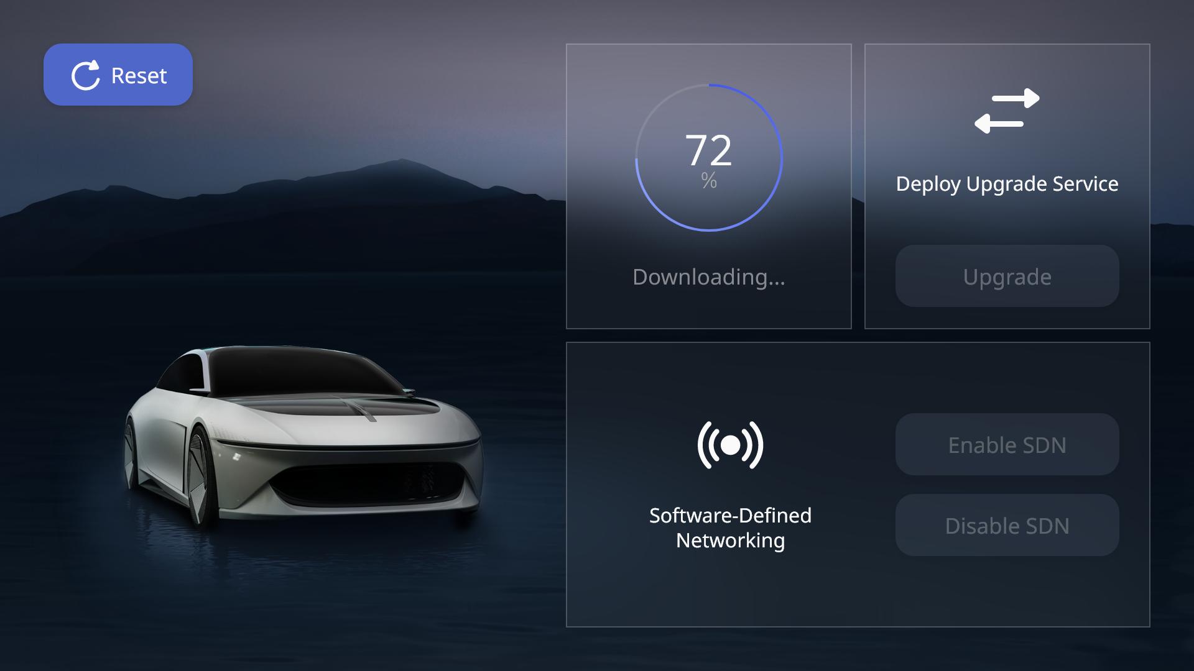
Control Panel – B(Deploy)

Slide 12
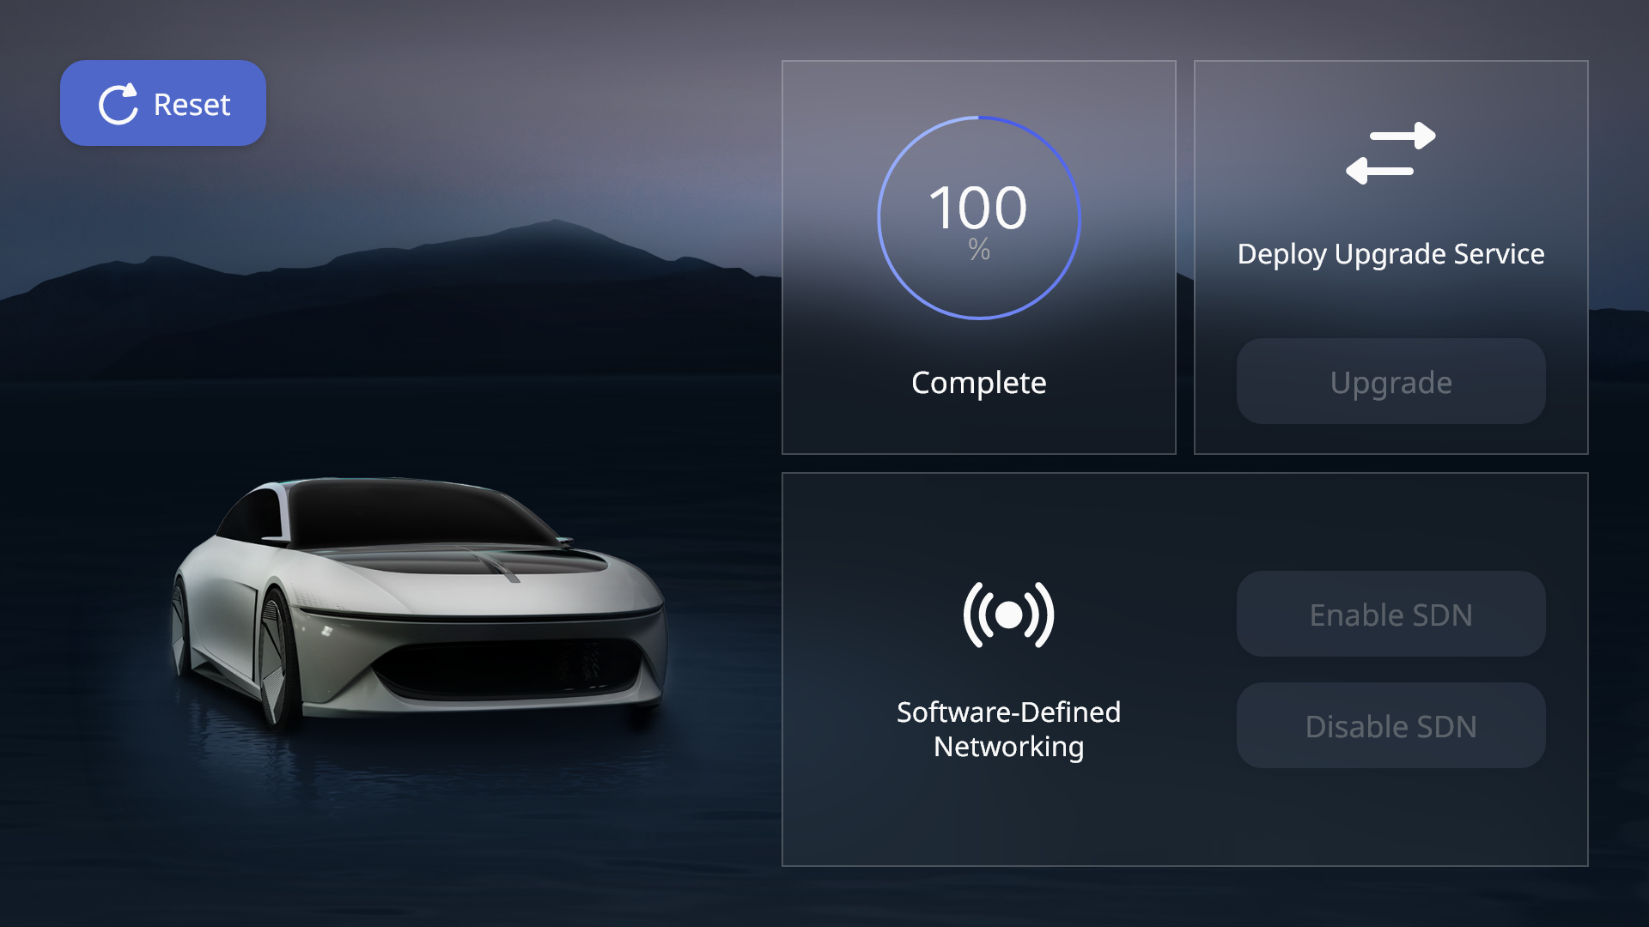
Control Panel – B(Deploy)

Slide 13
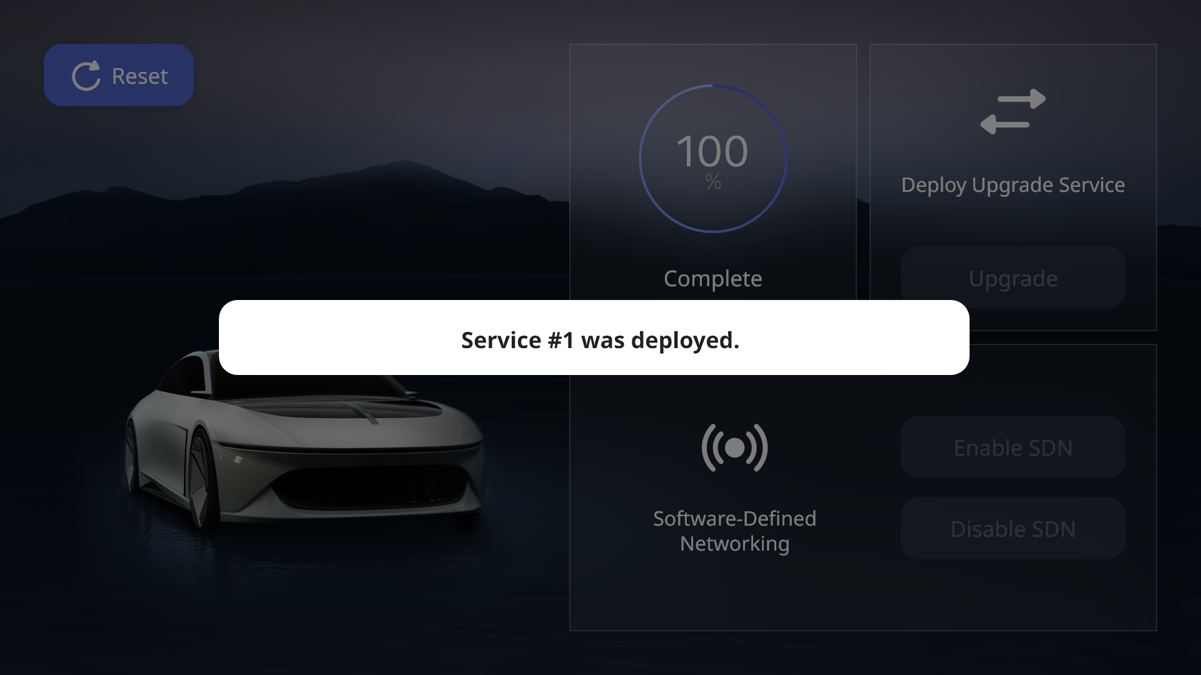
Control Panel – B(Deploy popup)

Slide 14
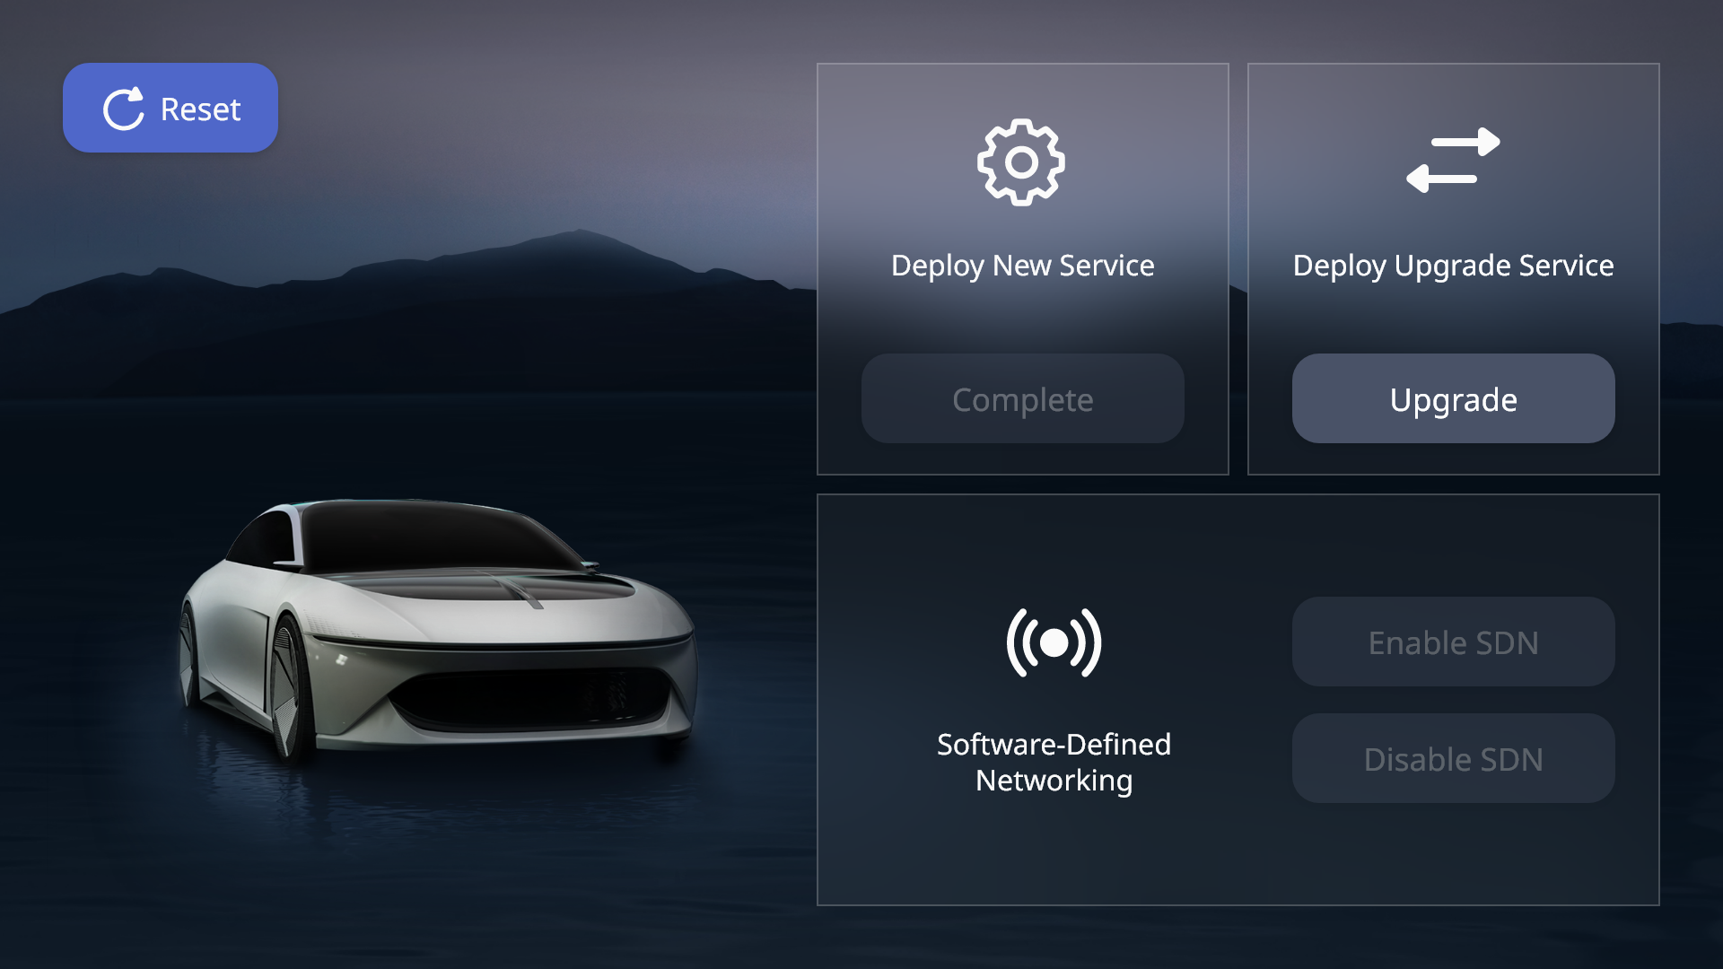
Control Panel – B(Upgrade)

Slide 15
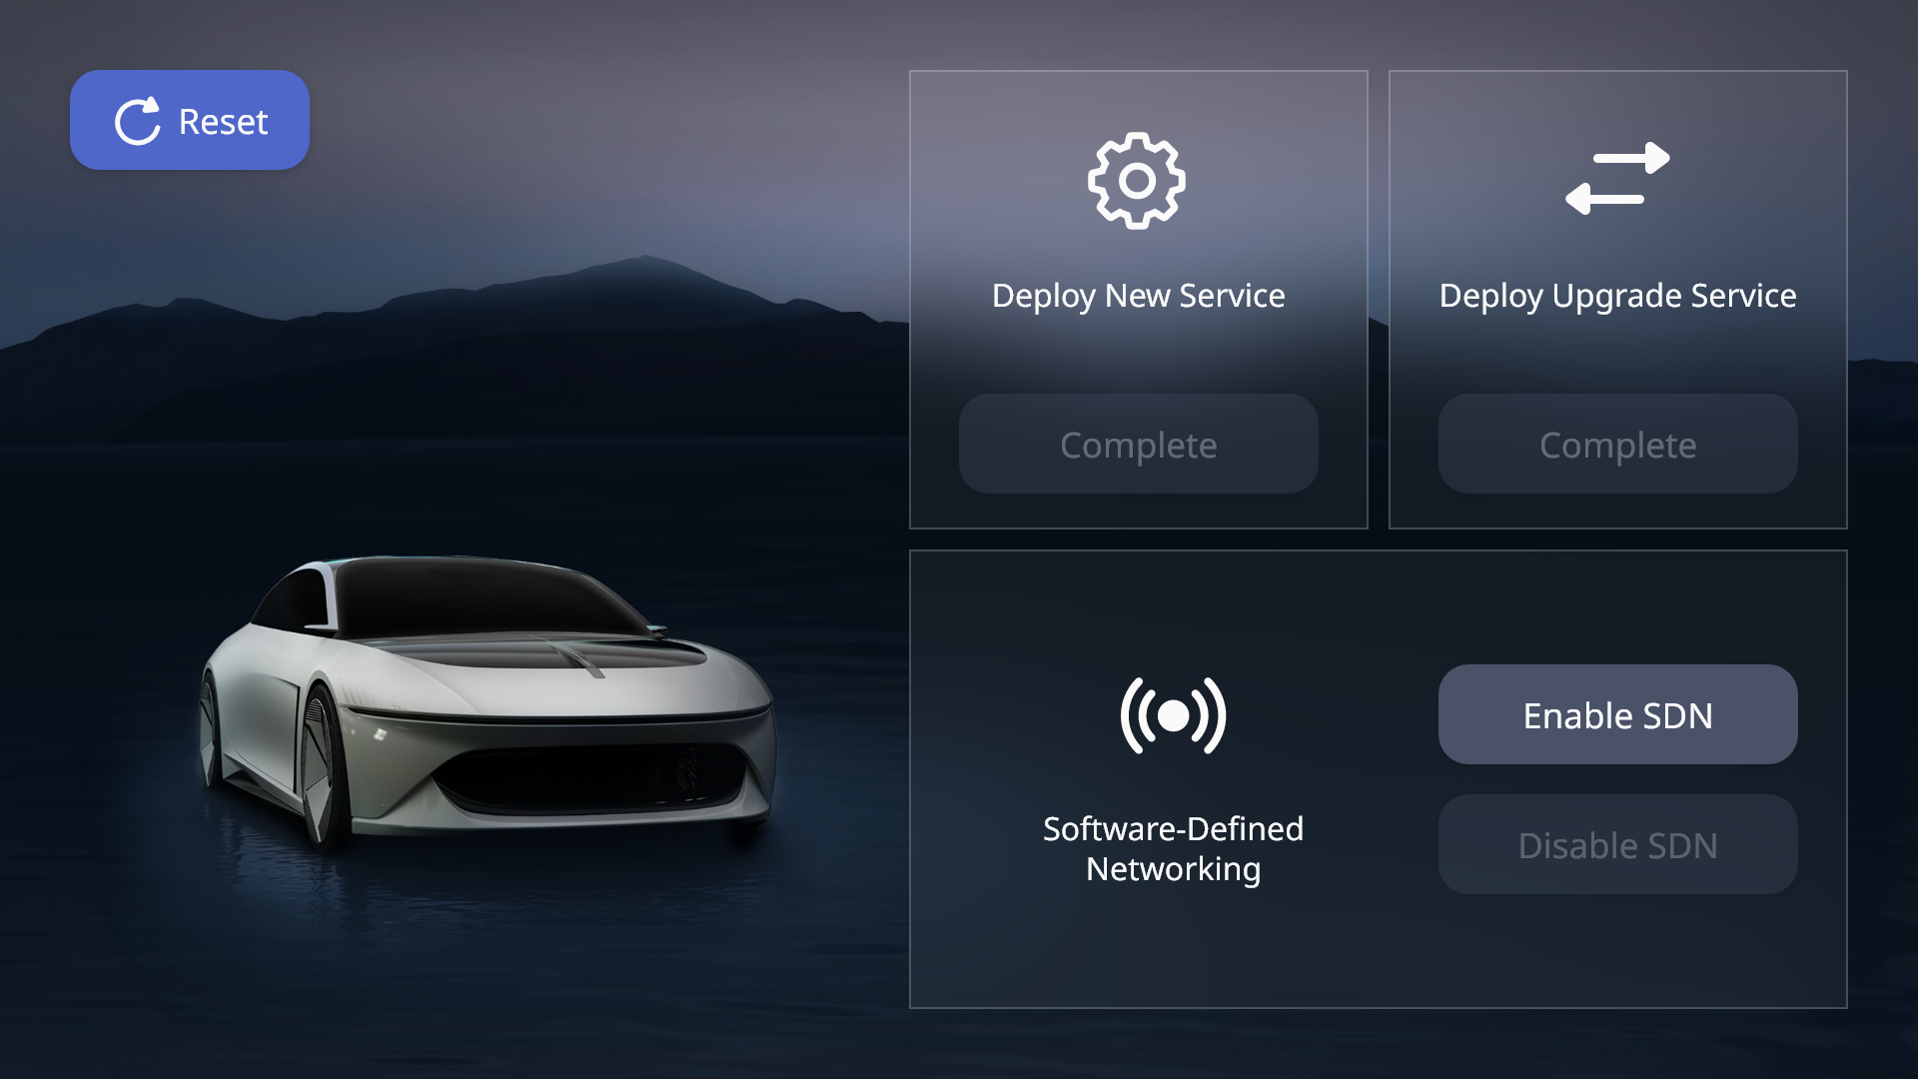
Control Panel – B(Enable SDN)

Slide 16
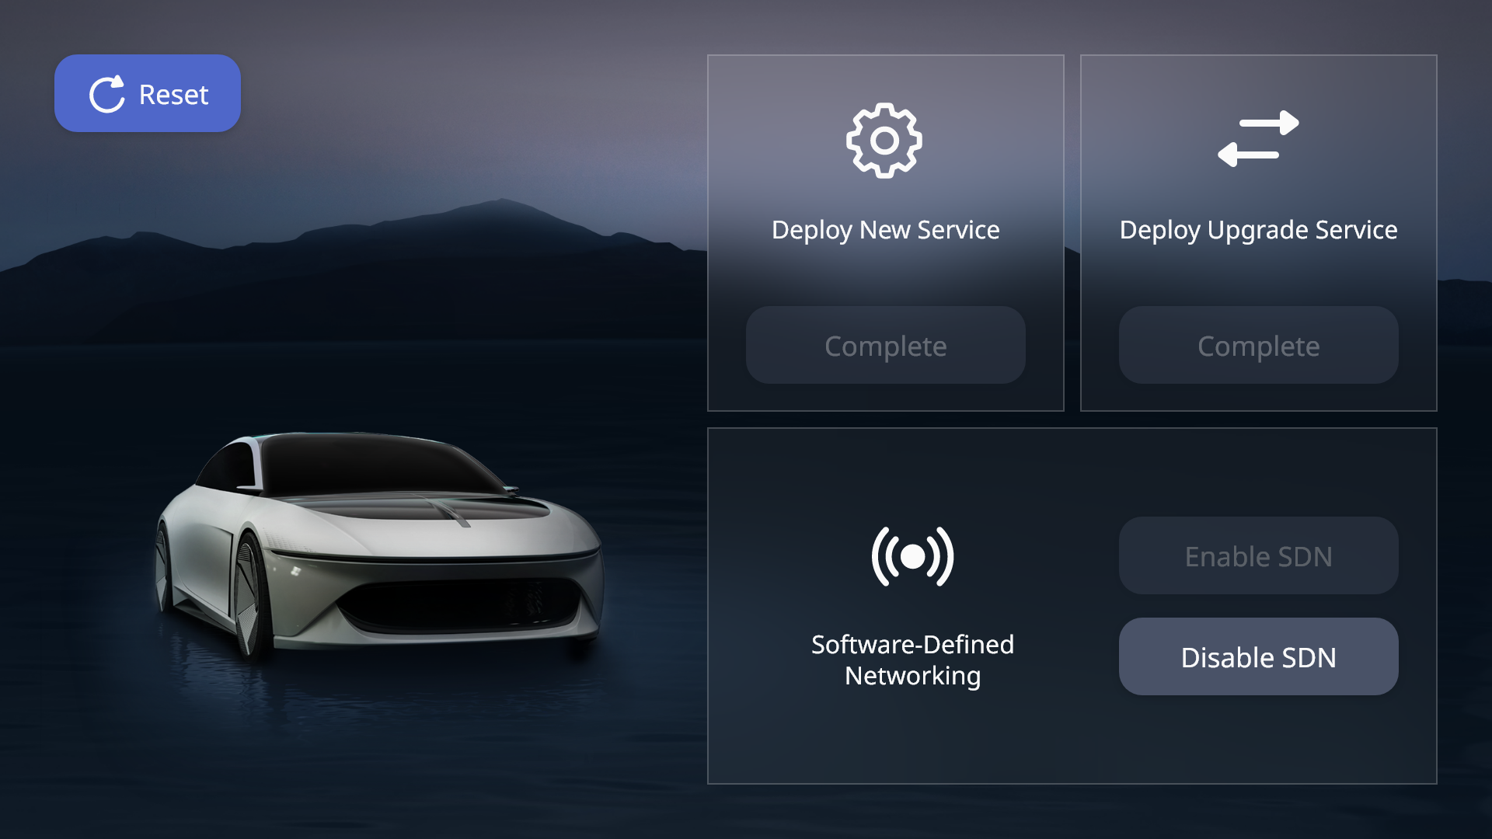
Control Panel – B(Disable SDN)

Slide 17
Control Panel – B(Reset)

Slide 18
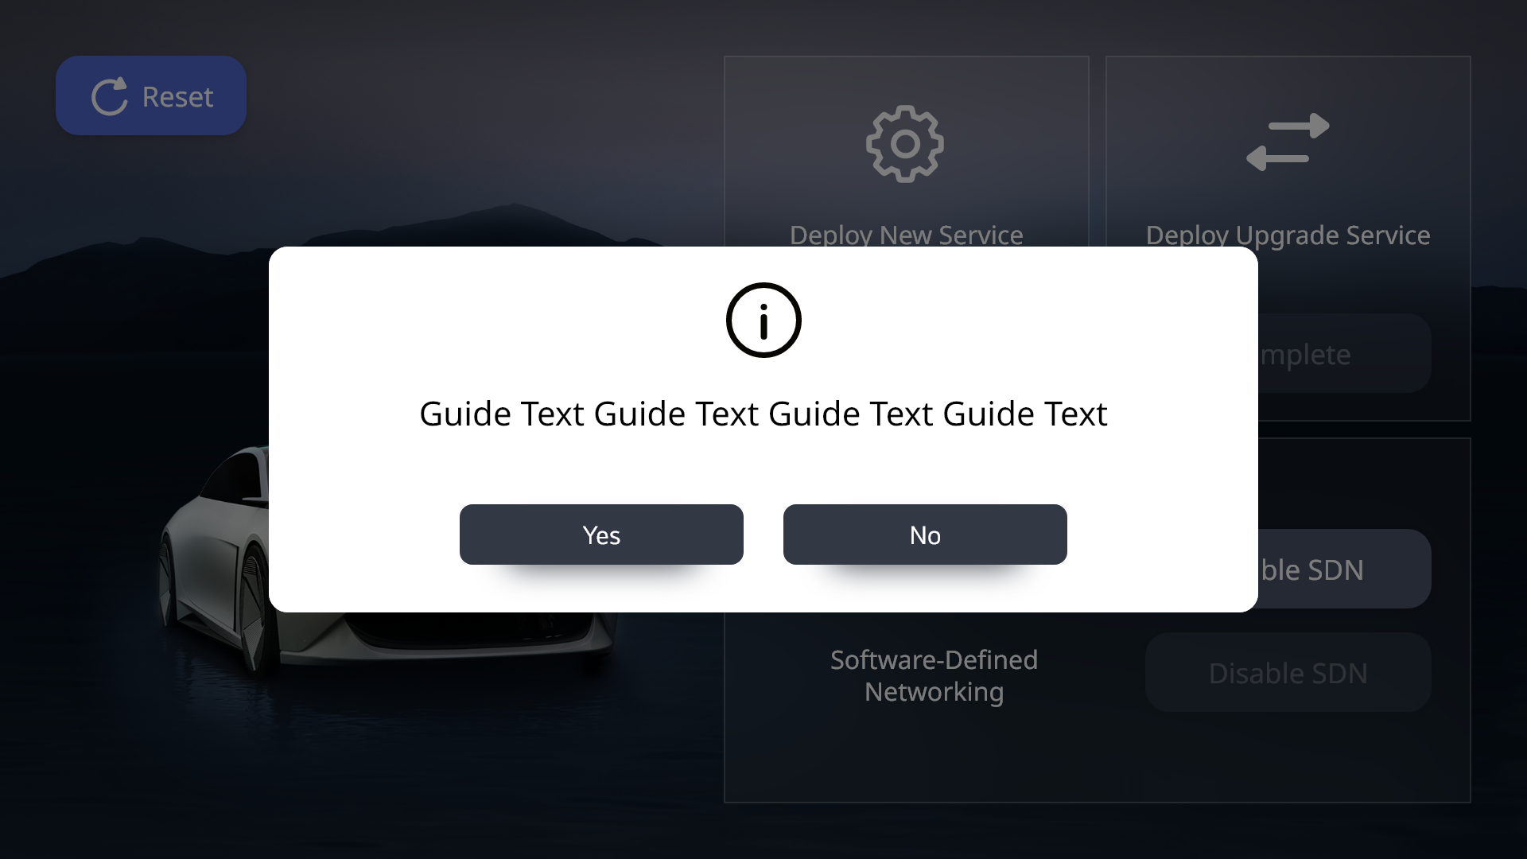
Control Panel – B(Reset popup)

Slide 19
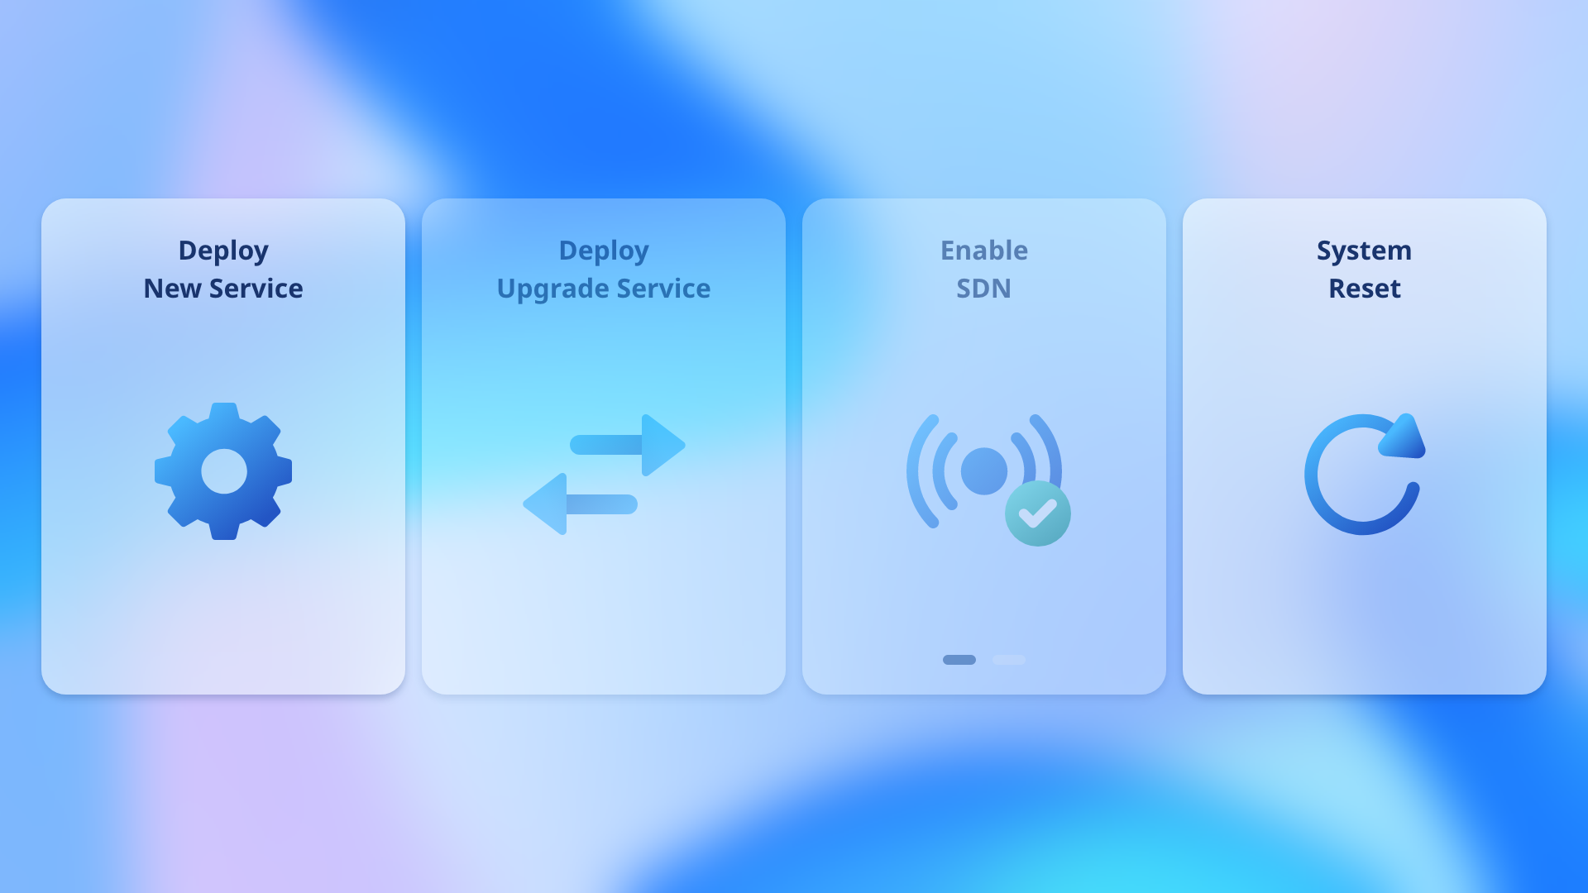
Control Panel – C

Slide 20
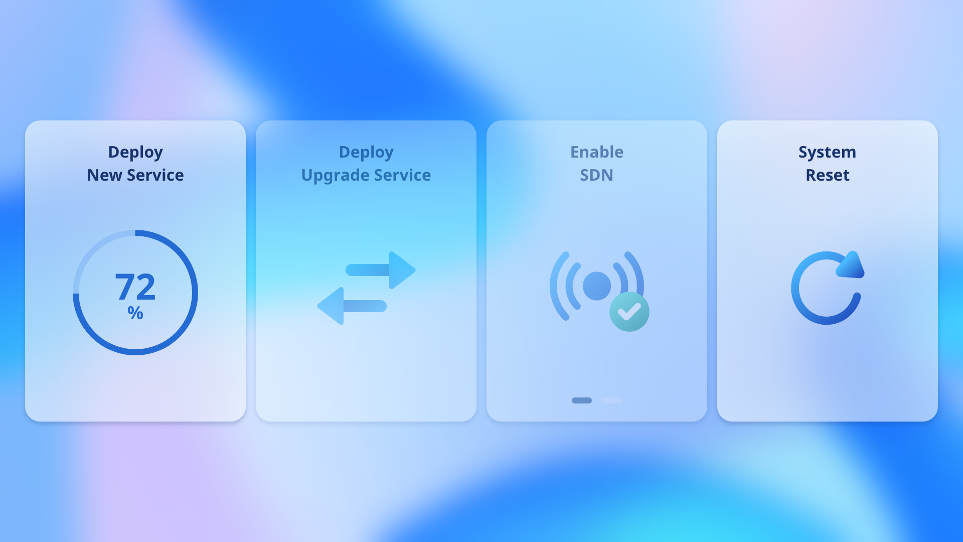
Control Panel – C(Deploy)

Slide 21

Control Panel – C(Deploy)

Slide 22
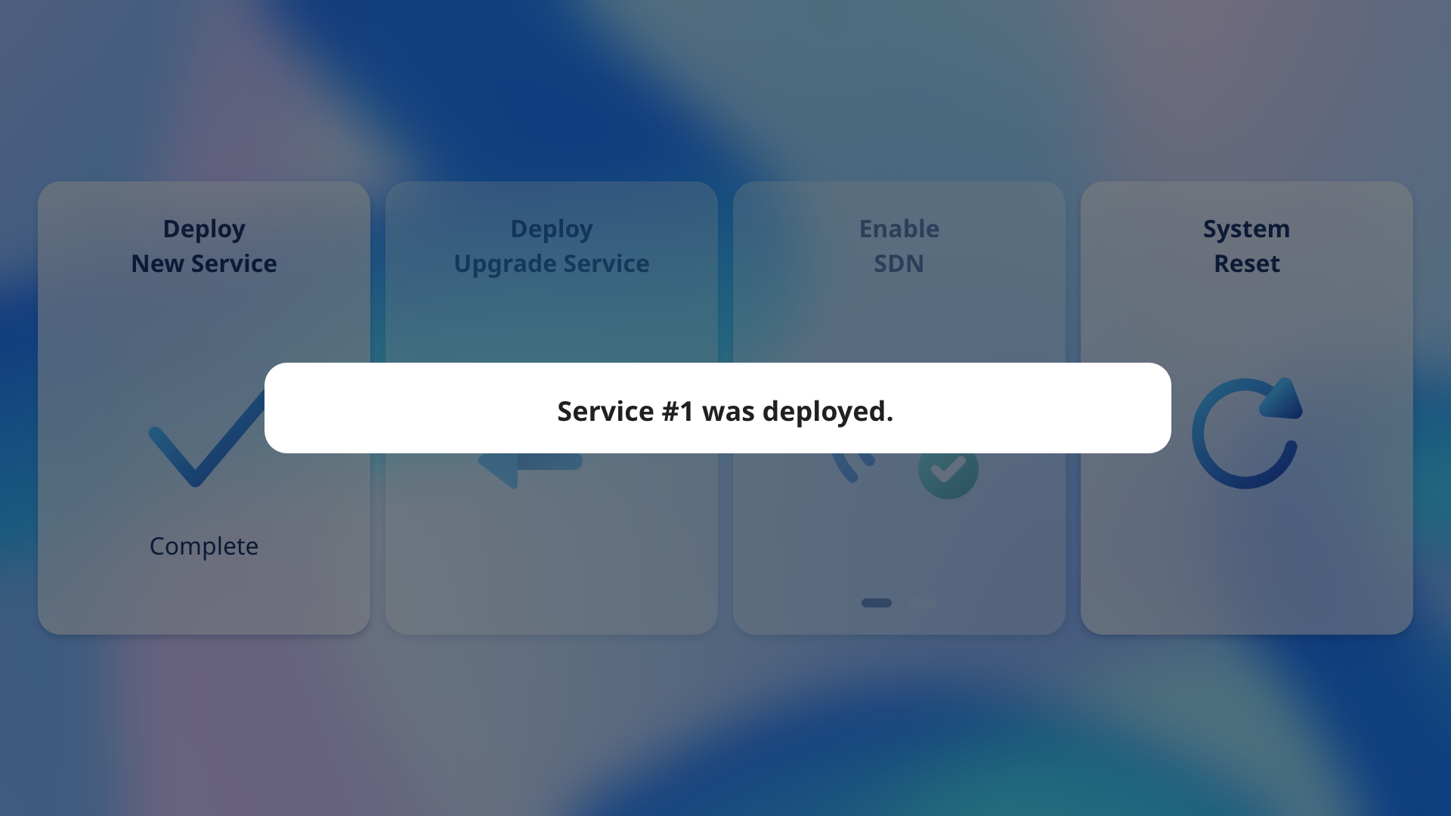
Control Panel – C(Deploy popup)

Slide 23
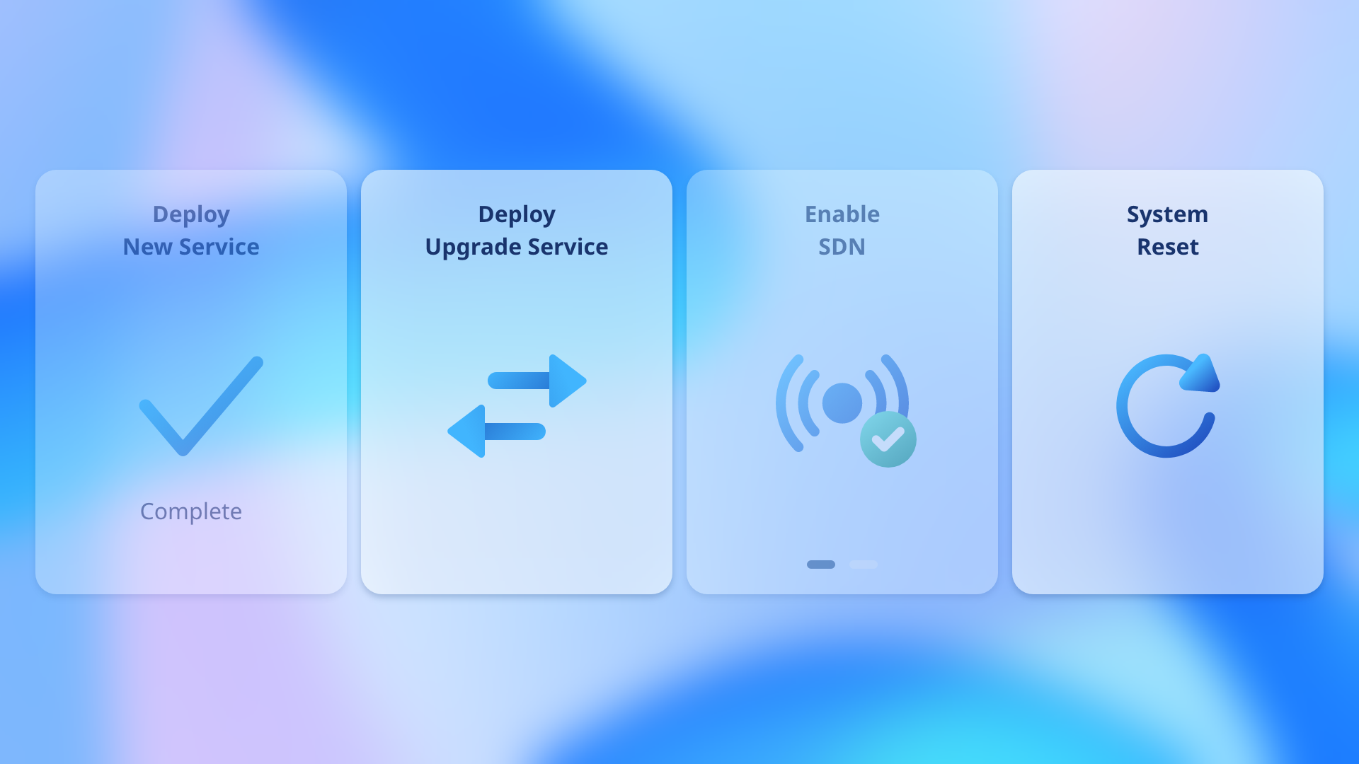
Control Panel – C(Upgrade)

Slide 24
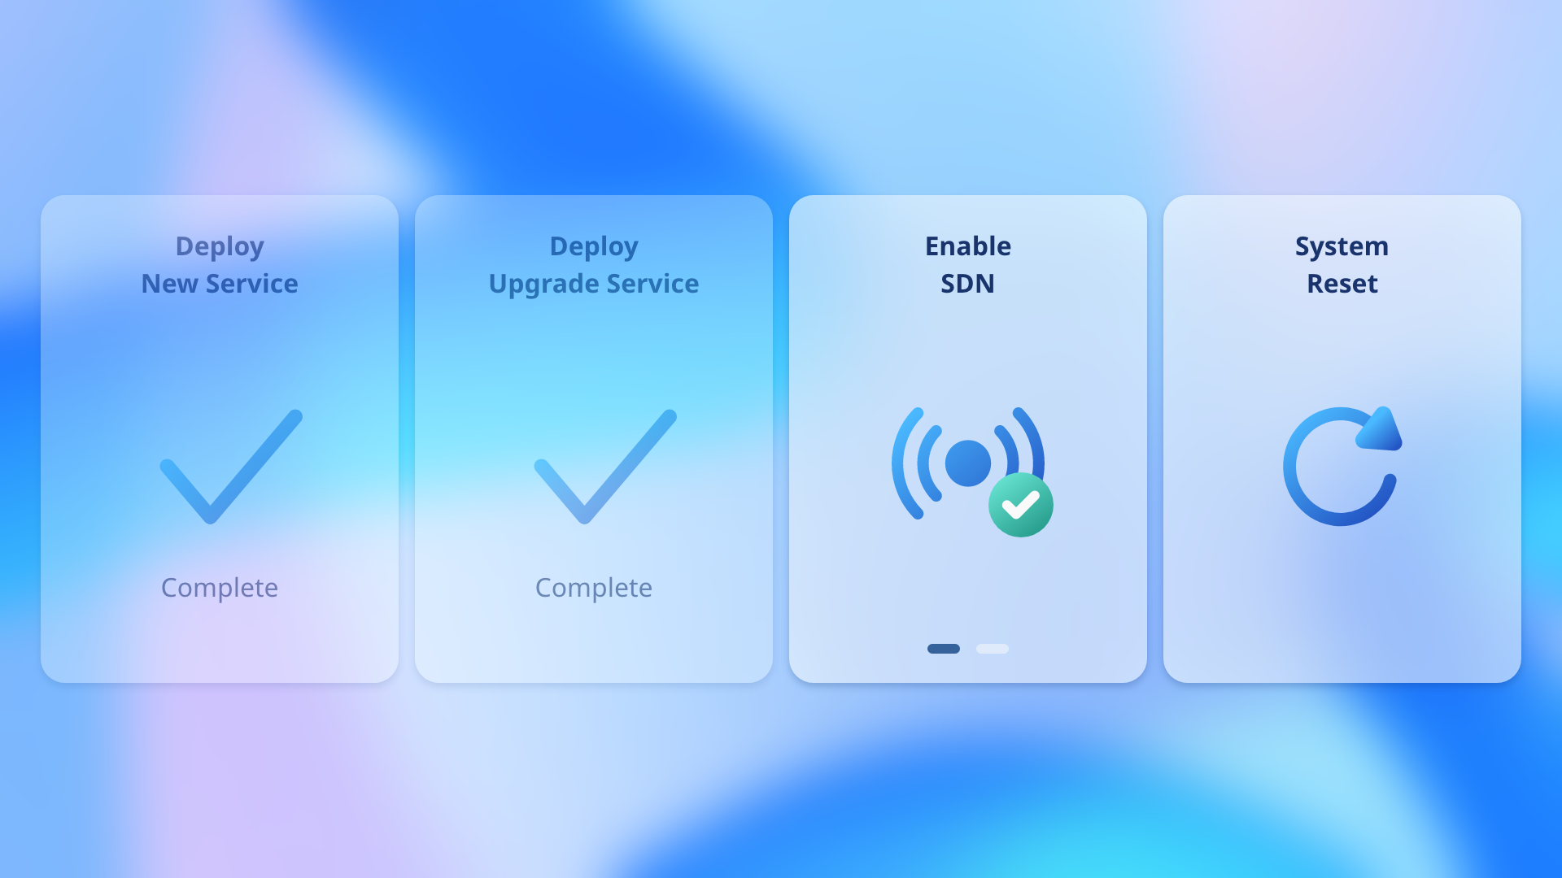
Control Panel – C(Enable SDN)

Slide 25

Control Panel – C(Disable SDN)

Slide 26
Control Panel – C(Reset)

Slide 27
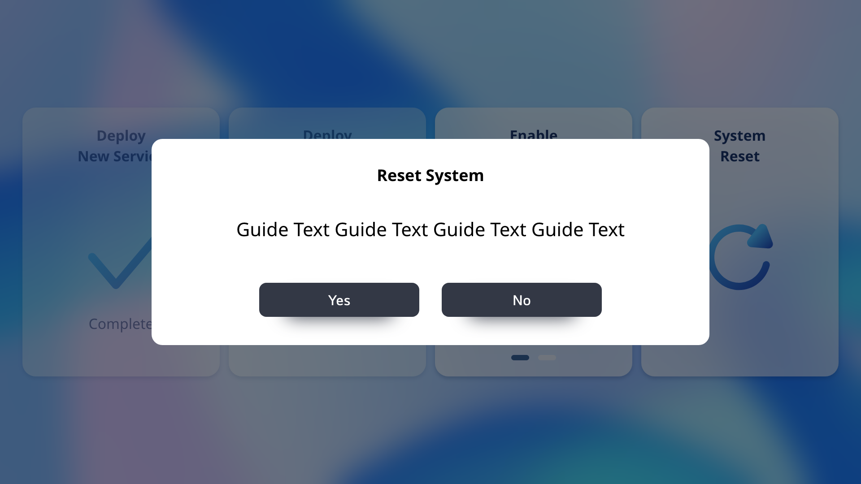
Control Panel – C(Reset Popup)

Slide 28
Network Node

Slide 29

Network Node - A

Slide 30
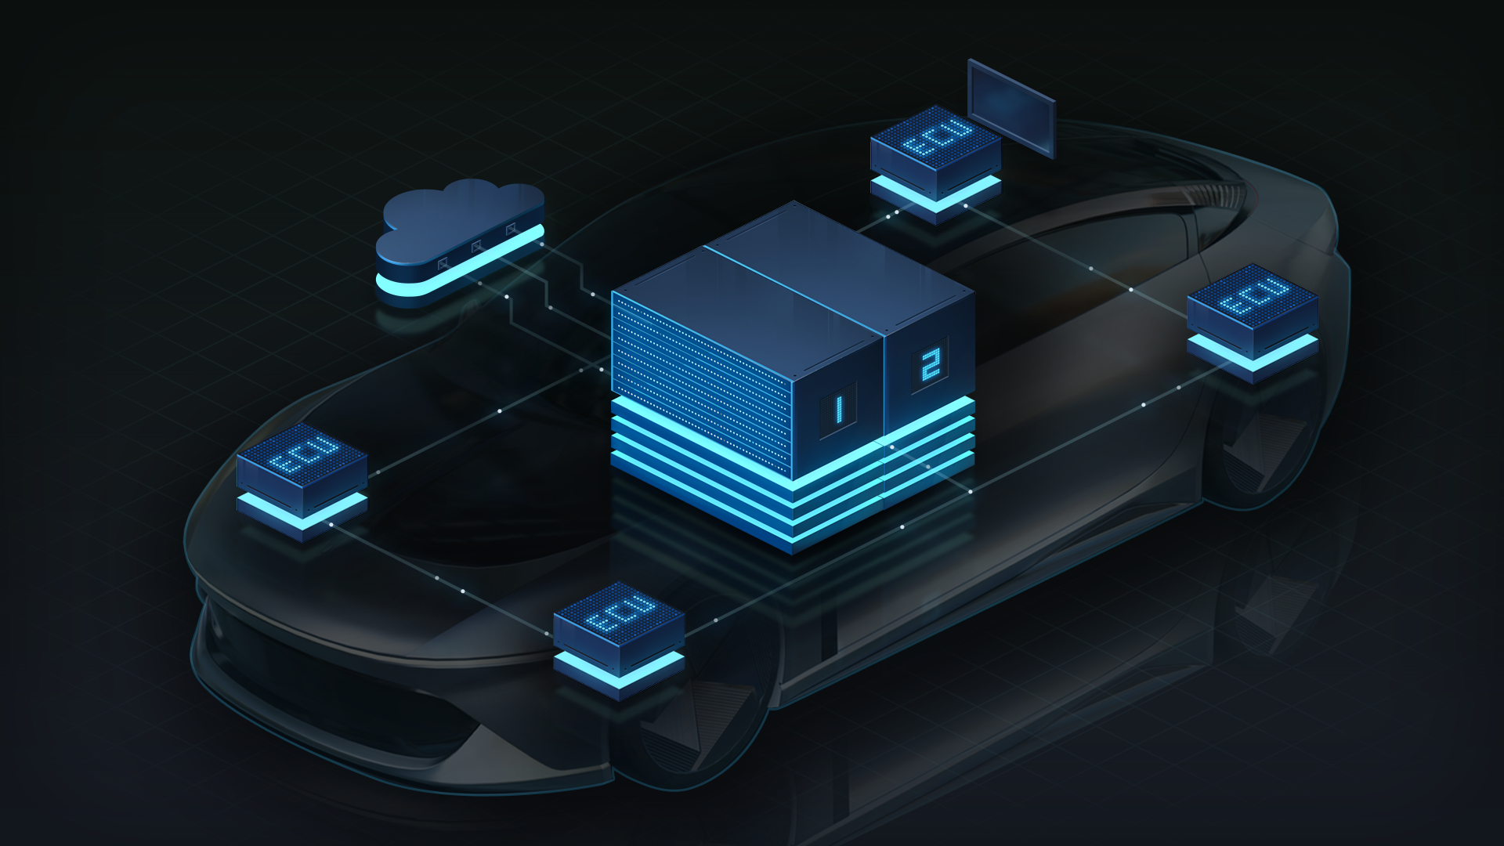
Network Node - B

Slide 31

Network Node - C

Slide 32
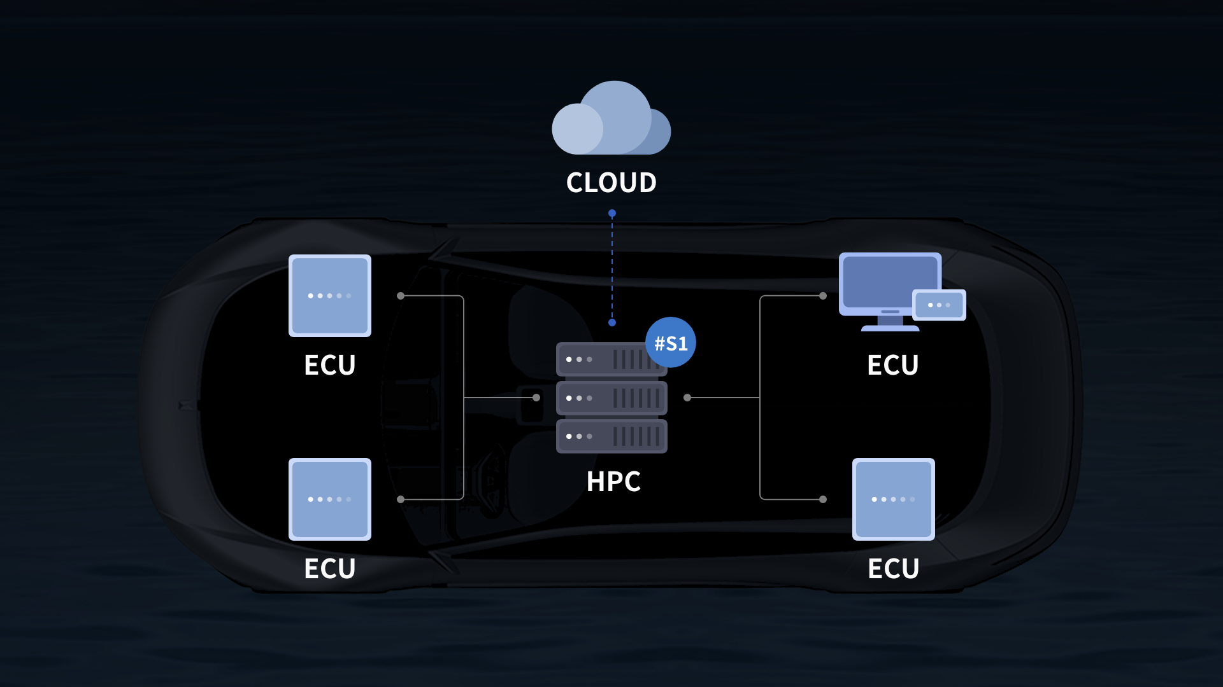
Network Node - D

Slide 33
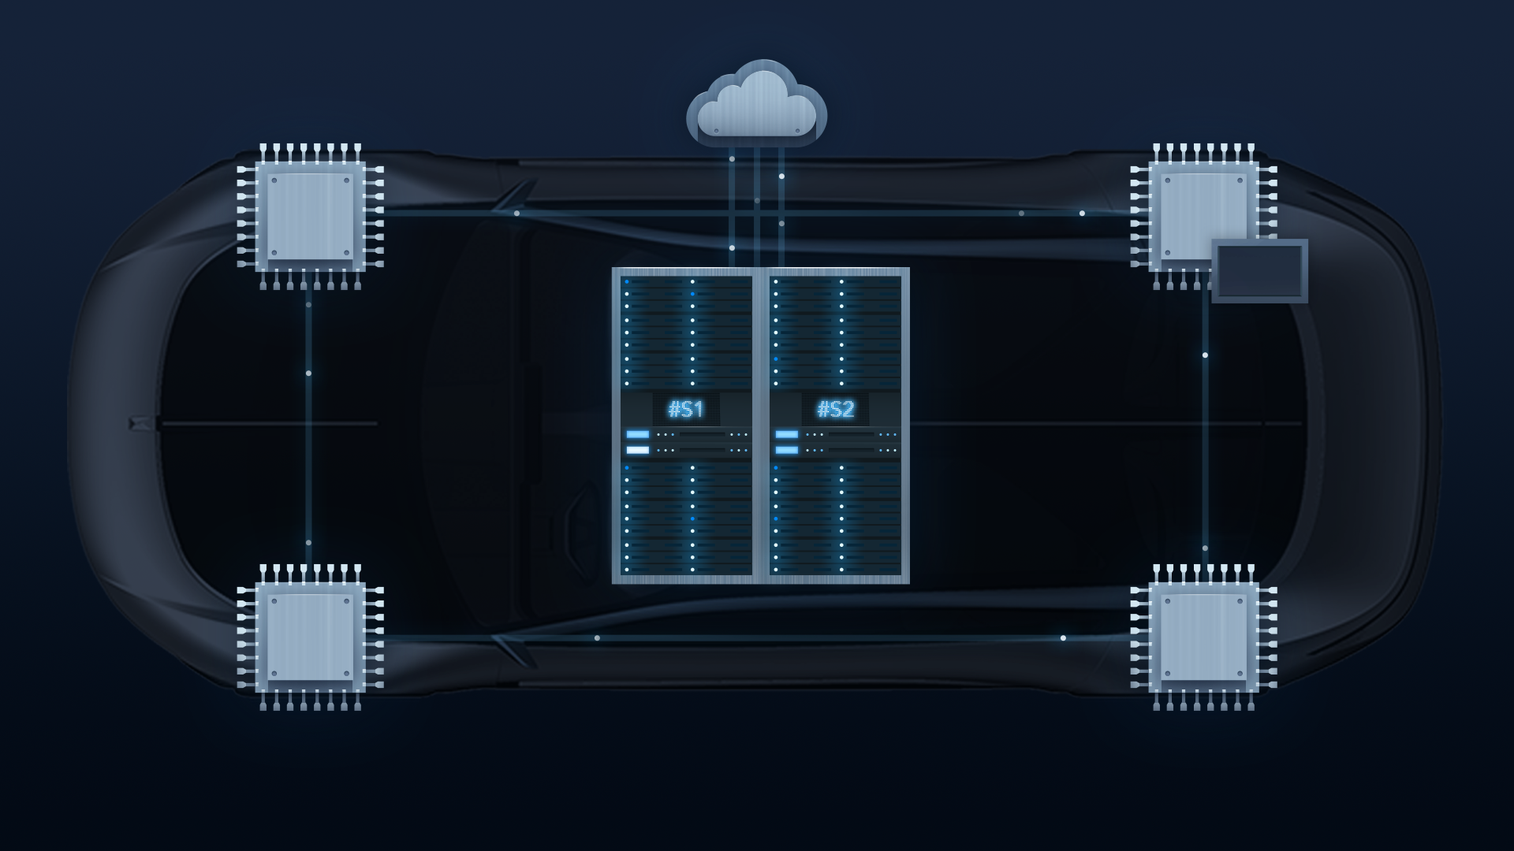
Network Node - E

